Slide 1
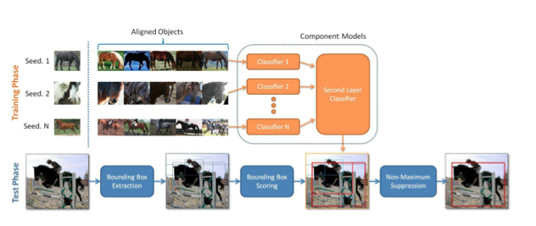
MULTI-COMPONENT MODELS FOR OBJECT DETECTION
By Erol Kazancli
based on a paper by Chunhui Gu, Pablo Arbelaez, Yuanqing Lin, Kai Yu,
and Jitendra Malik

Slide 2

MULTI-COMPONENT SCHEME
Components as visual clusters capturing intra-class variations.
Visual Clusters that are tight in appearance and configuration

Slide 3
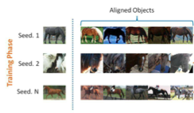
CLUSTER SELECTION
Select the seeds which are characteristic enough.
Align the rest of the objects with the seeds based on keypoints and mask.

Slide 4
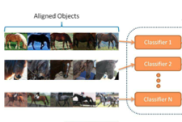
TRAINING Stage 1: 1st Layer Classifiers
Use top M aligned objects as positive.
Choose negative examples.
Train one classifier for each cluster using SIFT descriptors with SVM.

Slide 5
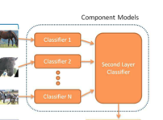
TRAINING Stage 2: 2nd Layer Classifier
Select the results of 1st layer classifiers as the inputs.
Obtain weights using SVM to produce a classification

Slide 6
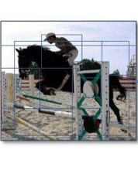
TESTING Stage 1: Bounding Box Generation
Apply segmentation.
Choose the smallest rectangle for each segment.
Remove duplicates.

Slide 7
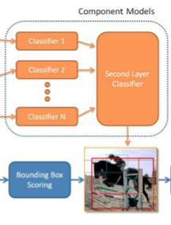
TESTING Stage 2: Bounding Box Scoring
Apply the 1st and 2nd layer classifiers sequentially to bounding boxes.
Score the bounding boxes accordingly.
Apply maximum suppression.

Slide 8
ADVANTAGES
Easy-to-learn and highly discriminative component models
A second layer classifier for aggregation
Improved intra-class variation handling
Fast bounding-box detection
Better results than monolithic models

Slide 9
DISADVANTAGES
Difficulty in determining seeds and alignment
Several layers which adds to complexity and time

Slide 10
POSSIBLE IMPROVEMENTS
Using average mask of all aligned objects rather than the mask of the seed
Using better bottom-up image segmentation cues

